Slide 1

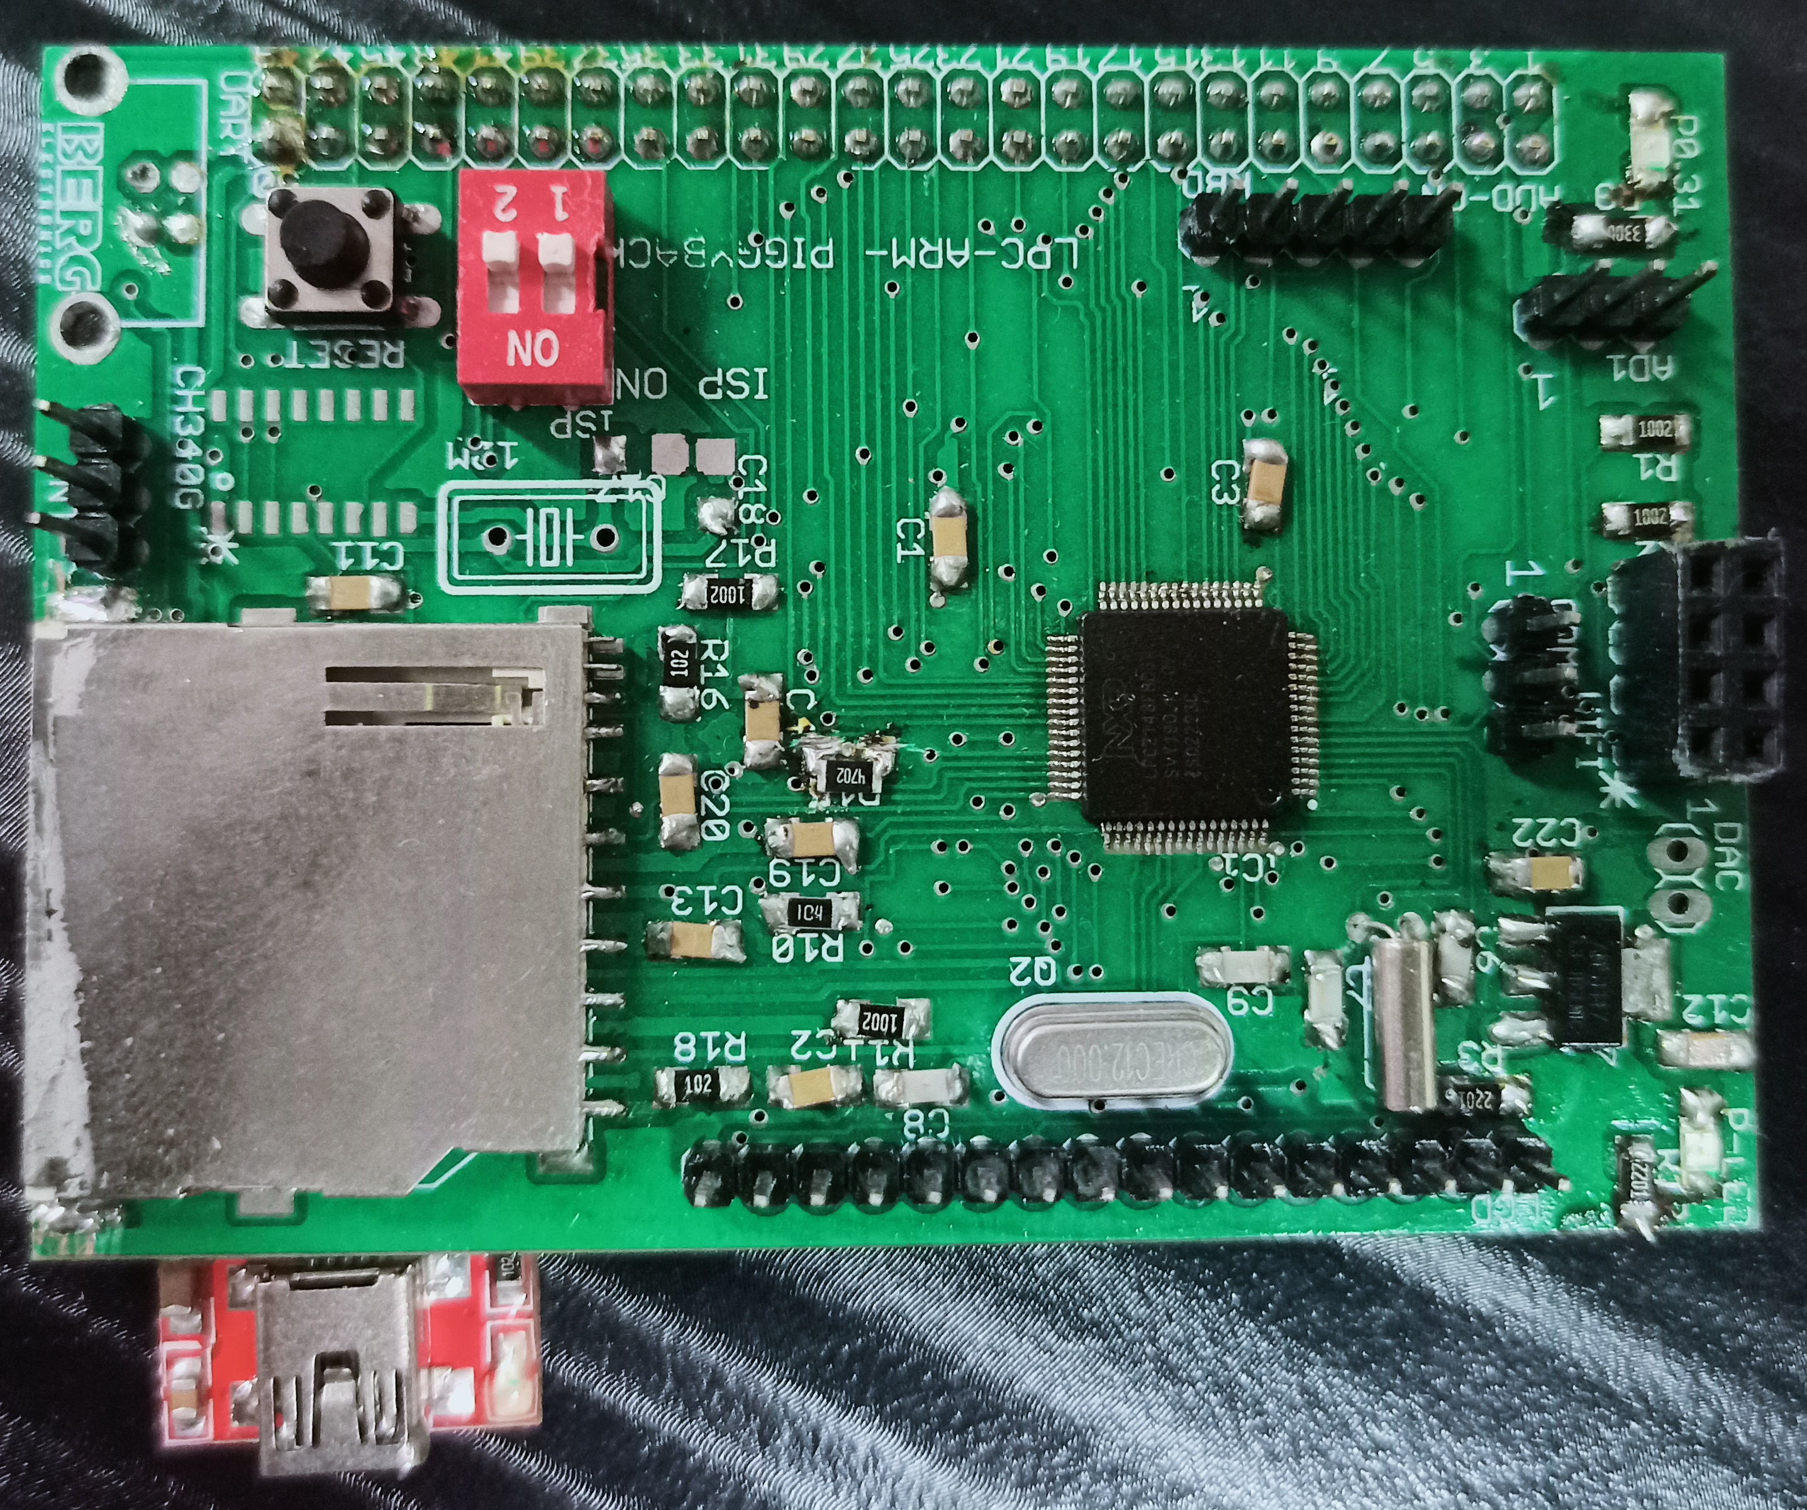
ARM-LPC2148 Piggyback Board
HARDWARE Laboratory Manual

Slide 2
Salient Features of ARM LPC2148
16/32-bit ARM7TDMI-S microcontroller in a tiny LQFP64 package.
8 to 40 kB of on-chip static RAM and 32 to 512 kB of on-chip flash program memory. 128 bit wide interface/accelerator enables high speed 60 MHz operation.
In-System/In-Application Programming (ISP/IAP) via on-chip boot-loader software.
USB 2.0 Full Speed compliant Device Controller with 2 kB of endpoint RAM.
In addition, the LPC2146/8 provide 8 kB of on-chip RAM accessible to USB by DMA.
One or two (LPC2141/2 vs. LPC2144/6/8) 10-bit A/D converters provide a total of 6/14 analog inputs, with conversion times as low as 2.44 μs per channel.
Single 10-bit D/A converter provides variable analog output.
Two 32-bit timers/external event counters (with four capture and four compare channels each), PWM unit (six outputs) and watchdog.
Low power real-time clock with independent power and dedicated 32 kHz clock input.
Multiple serial interfaces including two UARTs (16C550), two Fast I2C-bus (400 kbit/s), SPI and SSP with buffering and variable data length capabilities.
Vectored interrupt controller with configurable priorities and vector addresses.
Up to 45 of 5 V tolerant fast general purpose I/O pins in a tiny LQFP64 package.
Up to nine edge or level sensitive external interrupt pins available. 60 MHz maximum CPU clock available from programmable on-chip PLL with settling time of 100 μs.
On-chip integrated oscillator operates with an external crystal in range from 1 MHz to 30 MHz and with an external oscillator up to 50 MHz.
Power saving modes include Idle and Power-down.
Processor wake-up from Power-down mode via external interrupt, USB, Brown-Out Detect (BOD) or Real-Time Clock (RTC).
CPU operating voltage range of 3.0 V to 3.6 V (3.3 V ± 10 %) with 5 V tolerant I/O pads.

Slide 3
Salient Features of ARM-LPC2148 Piggyback Board
This ARM board is an evaluation board using LPC2148 ARM7TMDI-based microcontroller.
Power supply: USB +5V (500mA)
On-board linear regulators generate +3.3V/500mA USB connector
SD/MMC connector for SDCARD interface (MISO-P0.18, MOSI-P0.19, SCK-P0.17, SSEL-P0.20)
USB-UART FT232 RL B-type connector with Link-LED
2 line X 16 character LCD (D0-P1.16, D1-P1.17, D2-P1.18, D3-P1.19, D4-P1.20, D5-P1.21, D6-P1.22, D7-P1.23, RS-P0.2, R/W-P0.3, EN-P0.4)
Configurable for manual and automatic program download (ISP) via serial port.
Controllable LED on Port P0.31
50x2 Connector interface for base board of IoT platform
DAC on P0.25 (AOUT)
TXD0-P0.0, RXD0-P0.1, TXD1-P0.8, RXD1-P0.9
ADC0.1-P0.28, INT0-P0.16

Slide 4
Hardware Operational Guidelines
Switch OFF the USB Supply when mounting any external connecting wires or Sensors.
After completion of the wiring, ensure no short circuits and reverse connection of Supply and Ground pins. Any wrongdoing damages the power supply and permanently damages the electronic components.
Most of the components have a direction. Verify which is the Pin Number one in the case of ICs. In the case of LEDs, and Diodes find out Anode and Cathode terminals. In the case of external sensors, the Supply and ground pins.
Verify the rating of the components before interfacing i.e., Voltage and Current rating. Any kind of excess loading and reverse polarity may damage the electronic components.
When you are giving external Voltage to Digital ICs, & Microcontrollers make sure no signal voltage exceeds more than 3.3V (i.e., 0 to 3.3V, no negative signal) and do not draw a current of more than 10 mA from IC pins.
While writing the programs for LCD, Stepper Motor, DC Motor, Servo Motor, and Relay refer to the Connector details of the manual to know where these signals are available for interfacing purposes.
When you switch ON the power to the board the LED indicator shows power is OK. Similarly, LPC2148 uses the external USB-Micro B type cable for programming and giving power to the CPU, and Sensors.
If any components are hot or getting a burning smell immediately switch off the Supply and also remove the USB cable.
In such case disconnect all the external connections you have made and verify once again. If the problem exists, i.e. POWER LED is not getting ON then return the kit to the institute for maintenance purposes.
ISP OFF & RESET Switch on the LPC2148 is to restart executing the program.

Slide 5
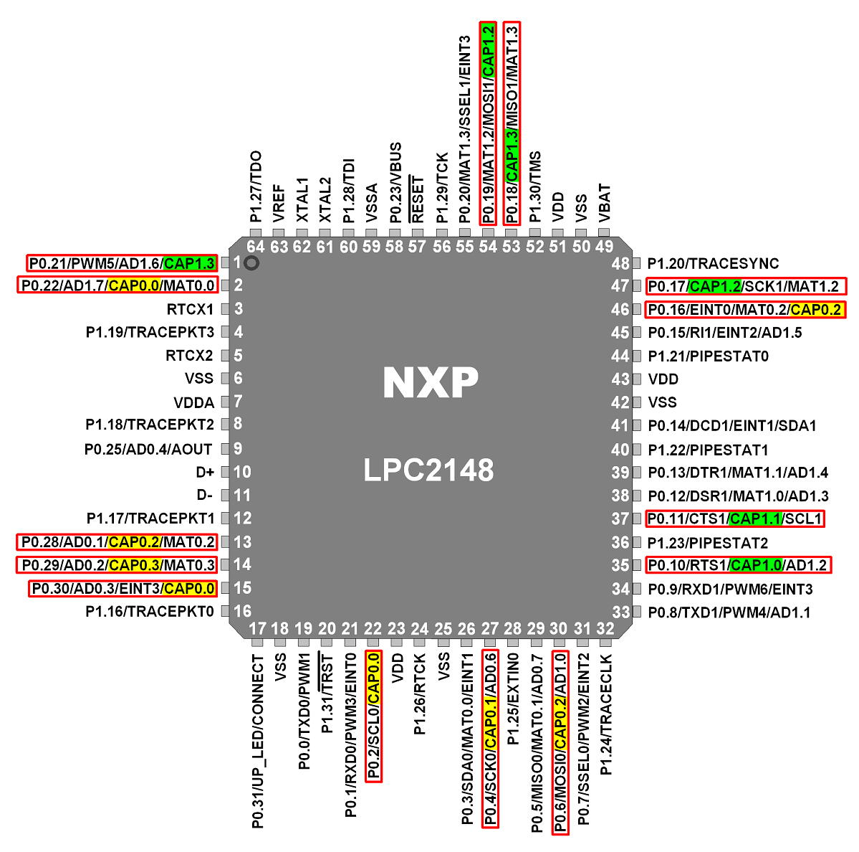
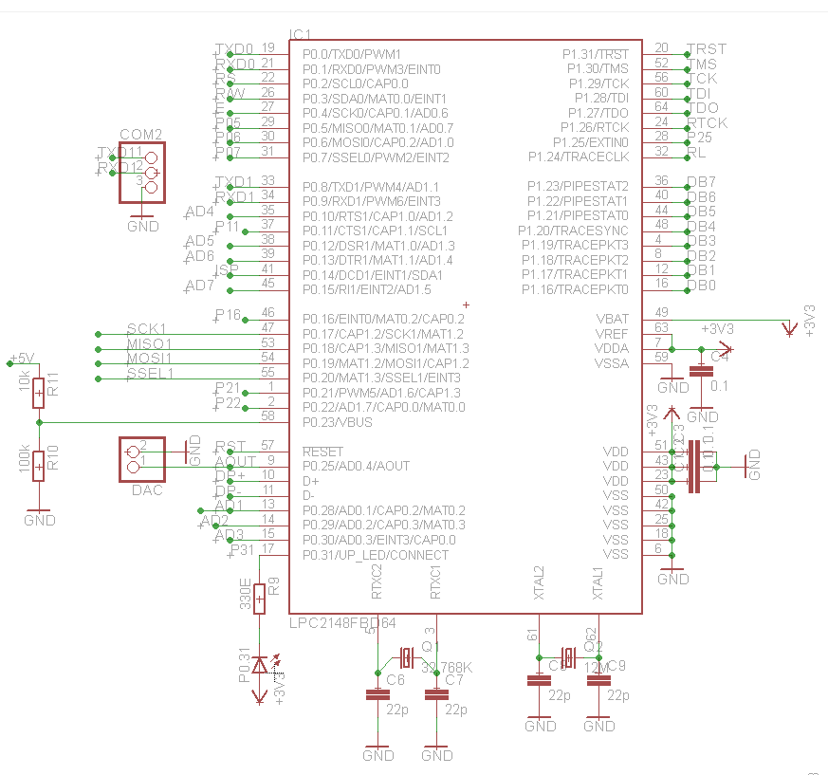
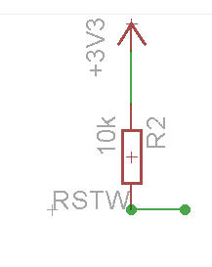
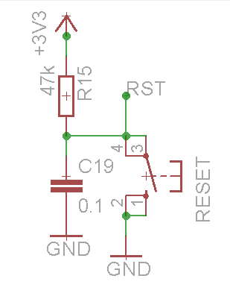
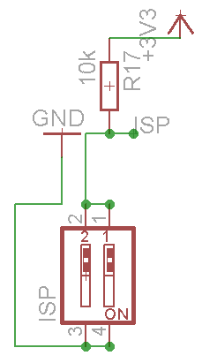
LPC2148 Minimum System
RESET
In system Programming

Slide 6
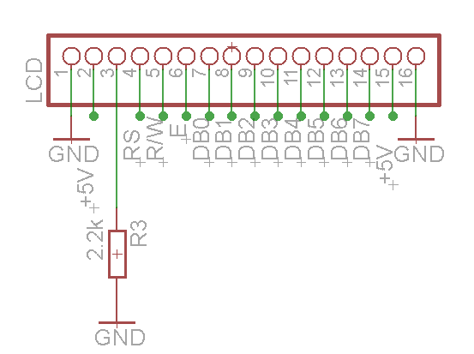
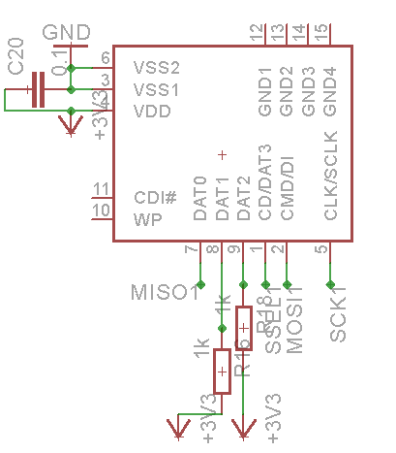
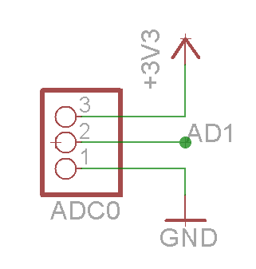
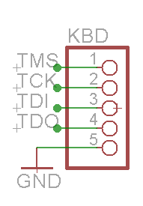
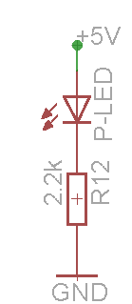
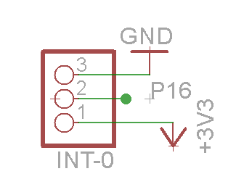
LPC2148 16x2 LCD Interface
LPC2148 SDCARD Interface
ADC0
4x1 KBD
INT0

Slide 7
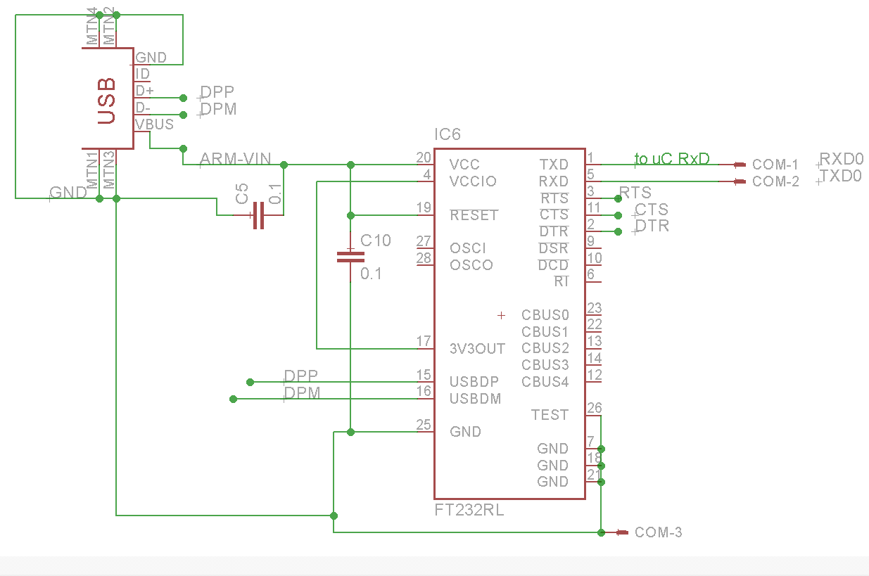
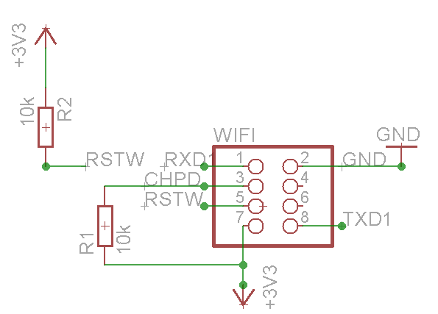
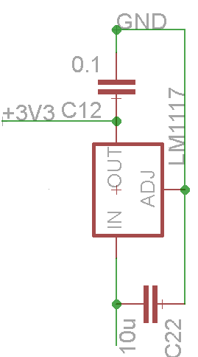
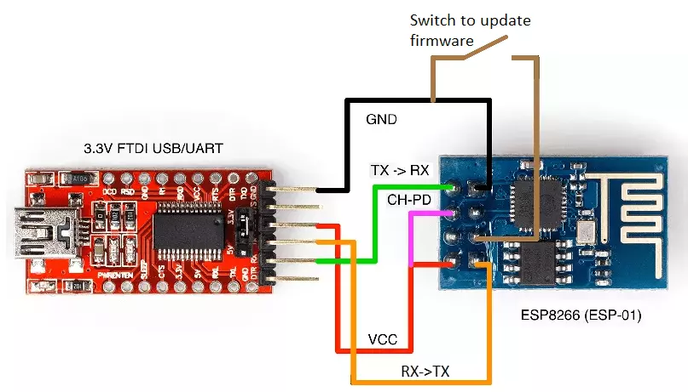
USB-UART Converter
Wi-Fi Interface

Slide 8
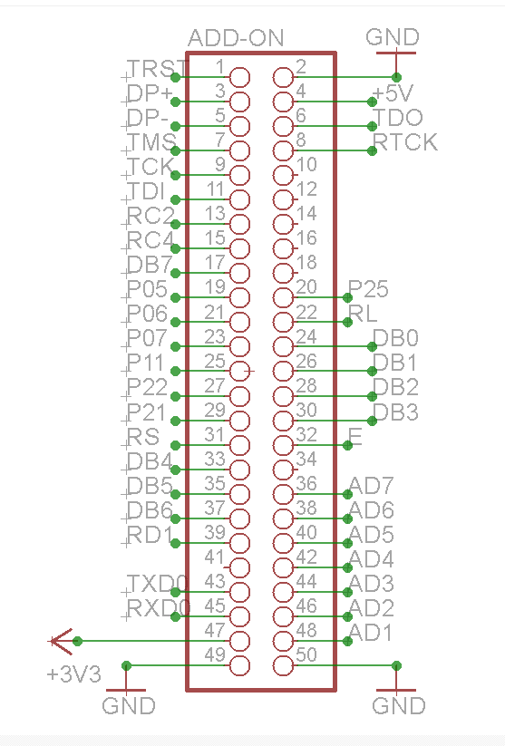
Piggyback Interface Connector

Slide 9
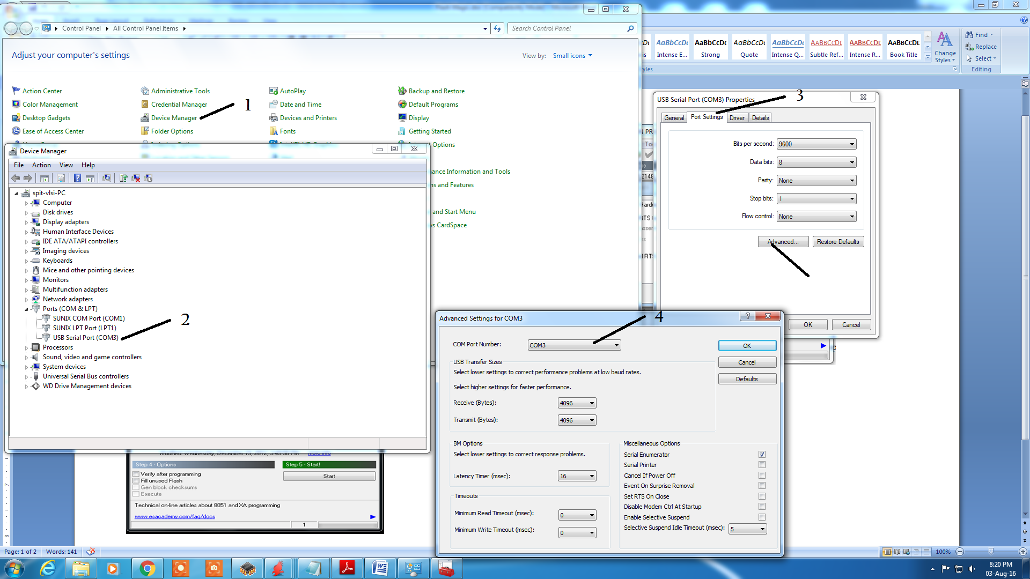
UART-USB Converter Device Driver (FT232)/(Prolific):
To program in Manual mode: and connect the USB cable to PC. To make the board enter programming mode:
Verify in Windows -> Control Panel-> 1.Device Manager-> 2.Ports-> Right click ->3. Properties-> 4.COM Port Number-> - Set to COM 3 (If not detected install FT232 device driver: CDM v2.10.00 WHQL Certified extract and give the path two times) -> Advanced select Single digit COM x number

Slide 10
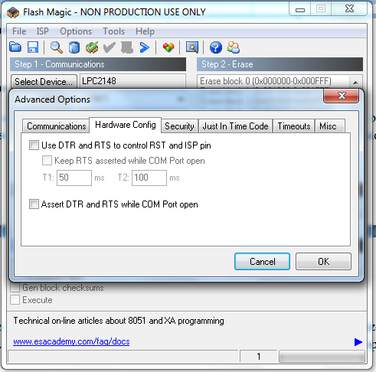
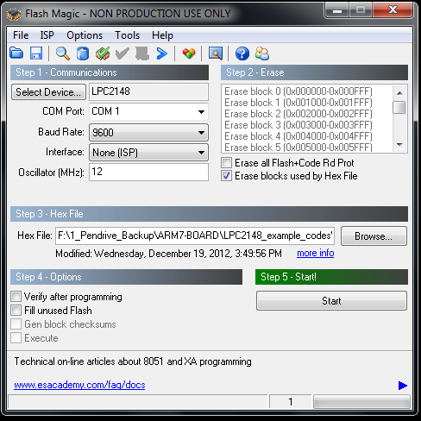
ARM-7 Programming using Flash Magic:
This board can be programmed through serial port using ‘Flash Magic’. ‘Flash Magic’ is a freeware windows utility used download the hex file format onto the board. Flash Magic can be downloaded from here http://www.flashmagictool.com/.
To program in ISP mode : connect the USB cable to PC. To make the board enter programming mode:
Verify in Windows -> Control Panel-> Device Manager-> Ports-> COM Port Number-> (If not detected install FT232 Driver )
I- ON ISP ( Switch ON to make it ISP Mode)
RESET ARM-7 Board (the controller enters the boot loader mode if during RESET the ISP pin is low)
Flash Magic Settings:
Select Device: LPC2148
COM Port: COM x (As per Device Manager Indication)
Baud Rate: 9600
Interface: (None) ISP
Oscillator: 12 Mhz
Erase Blocks used by Hex file: yes
Advanced Options: Use DTR and RTS to control RST and ISP pin: NO
Browse - > .HEX file -> Start (wait for Programming finished message to display)
Switch OFF ISP Switch
Press REST Switch to execute the program

Slide 11
Lecture Videos Link:
https://www.youtube.com/user/EMTRONTechnologies

Slide 12

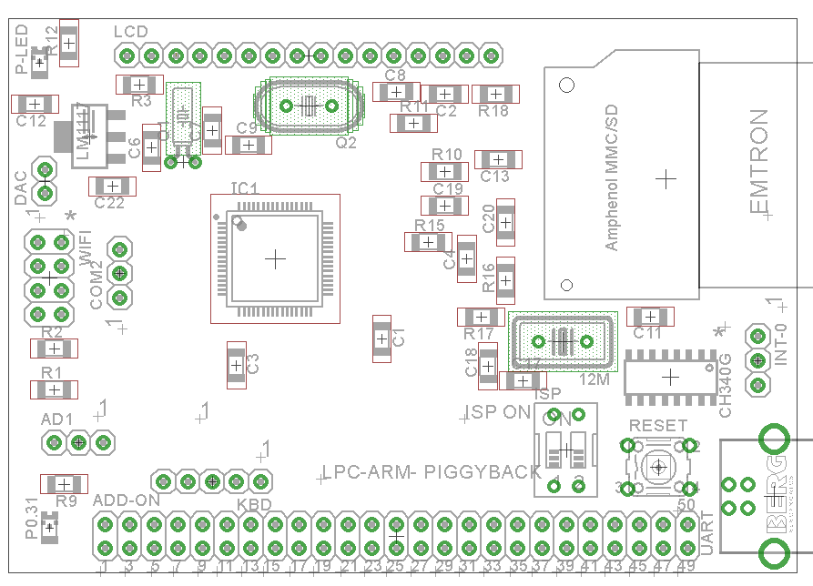

COMPONENT PLACEMENT

